Slide 1
Match and reconstruct
Guideline
Load images
Stereo Matching
Calculate Depth (z value)
Calculate x and y
Generate and store
the point cloud (x y z)

Slide 2
Match and reconstruct
Inputs:
Left and right image. (Notice that the epipolar of two images are parallel, so you don’t need to rectify the images. You could match the corresponding pixels row by row directly.
Calibration data of two cameras
Outputs (What you need to get and submit)
A disparity map
The 3D point cloud data (Save it in pc.txt and each row stores the x, y, and z coordinates of one point. And x, y, z values should be separated by one Space)
Your report (Explain the principle and implementation of the stereo matching algorithm you used in detail.)

Slide 3
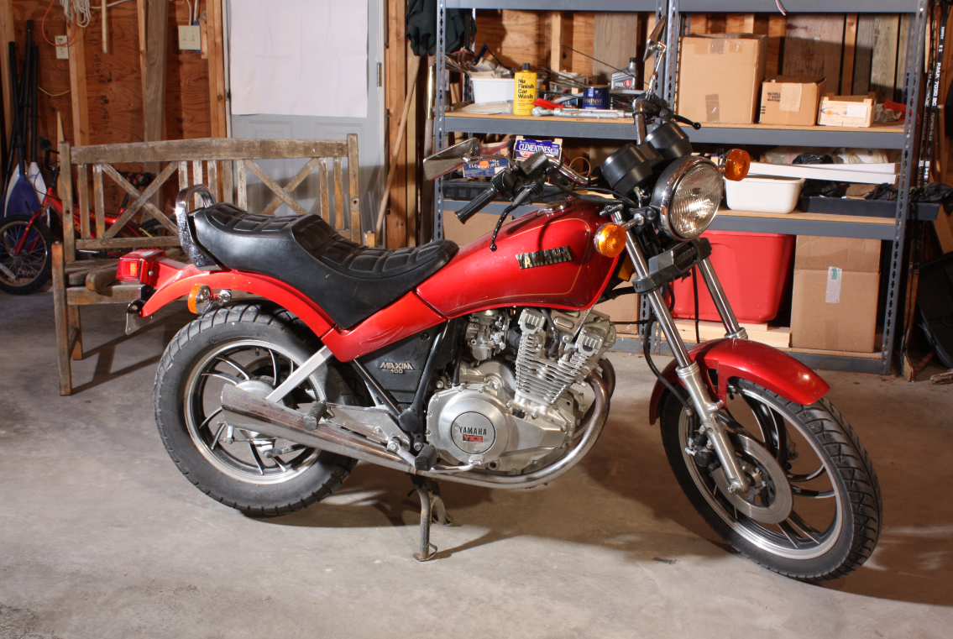
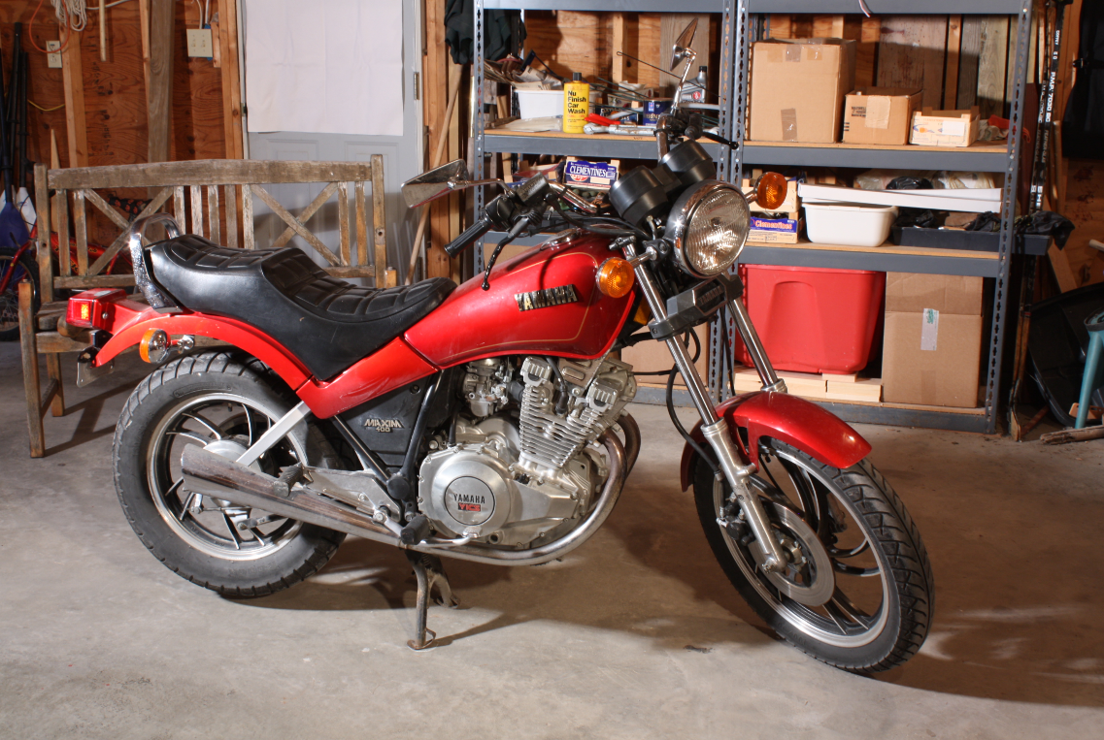
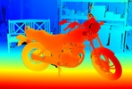
Match and reconstruct
Left image
Right image
Ground truth for reference
Stereo Match:
Write a program to stereo match the left and right image. Specifically, for each pixel in the left image, calculate the best matching point in the right image, and store the disparity (horizontal position absolute of the matched pixel) in a new matrix, and finally generate a disparity map.
You can choose any of the stereo matching algorithms to finish it. For example, you can use local algorithms such as SAD, SSD, STAD. You can also use global(or semi-global) algorithms such as SGM, PatchMatch and so on.
Notice that you can use any programming language and necessary libraries, but the library functions associated with stereo matching are not allowed to be used directly. You have to implement the stereo matching part of the code by yourself.

Slide 4
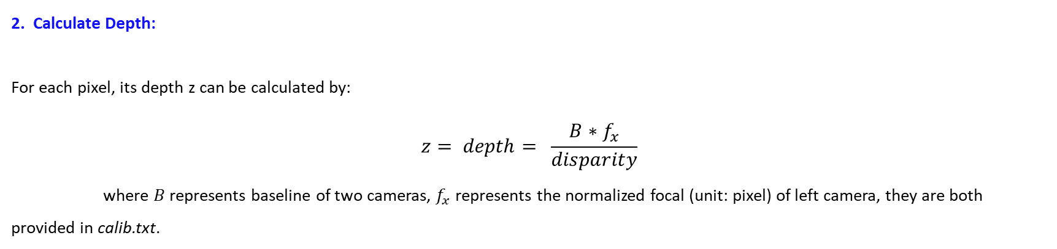
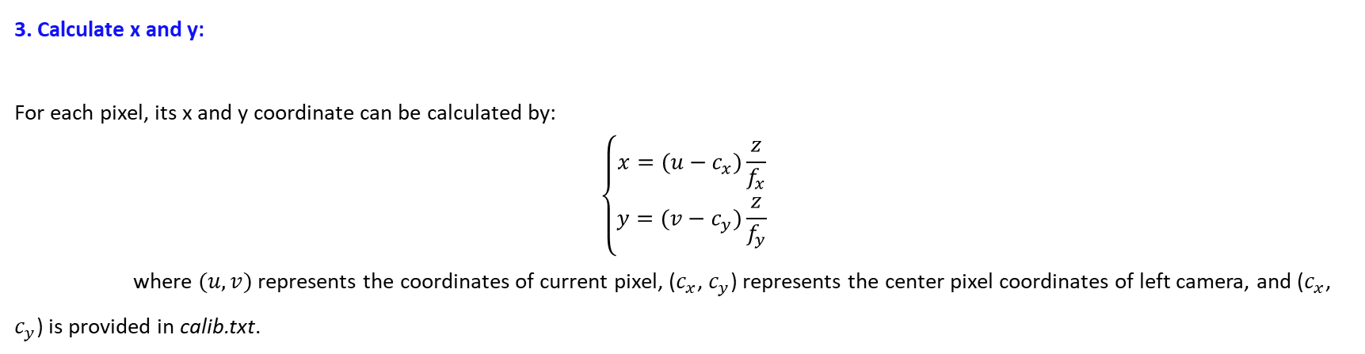
Match and reconstruct
2. Calculate Depth:
For each pixel, its depth z can be calculated by:
$$z= depth= \frac{B∗f_{x}}{disparity}$$
where $B$ represents baseline of two cameras, $f_{x}$ represents the normalized focal (unit: pixel) of left camera, they are both provided in calib.txt.
3. Calculate x and y:
For each pixel, its x and y coordinate can be calculated by:
$$\left\{\begin{aligned}x=(u−c_{x})\frac{z}{f_{x}} \\ y=(v−c_{y})\frac{z}{f_{y}}\end{aligned}\right.$$
where $(u,v)$ represents the coordinates of current pixel, ($c_{x}$, $c_{y}$) represents the center pixel coordinates of left camera, and ($c_{x}$, $c_{y}$) is provided in calib.txt.

